Slide 1
Styles of unit test

Slide 2
What will you learn?
Comparing styles of unit testing
The relationship between functional and hexagonal architectures
Transitioning to output-based testing

Slide 3
Three styles of unit testing

Slide 4
Three styles of unit testing
Output-based testing
State-based testing
Communication-based testing

Slide 5
Output-based testing
Where you feed an input to the system under test (SUT) and check the output it produces
public class PriceEngine
{
public decimal CalculateDiscount(params Product[] products)
{
decimal discount = products.Length * 0.01m;
return Math.Min(discount, 0.2m);
}
}
[Fact]
public void Discount_of_two_products()
{
var product1 = new Product("Hand wash");
var product2 = new Product("Shampoo");
var sut = new PriceEngine();
decimal discount = sut.CalculateDiscount(product1, product2);
Assert.Equal(0.02m, discount);
}
SUT w/ inputs
Notes:
The first style of unit testing is the output-based style, where you feed an input to the system under test (SUT) and check the output it produces (figure 6.1).
This style of unit testing is only applicable to code that doesn’t change a global or internal state, so the only component to verify is its return value. the only outcome of the CalculateDiscount() method is the discount it returns: the output value

Slide 6
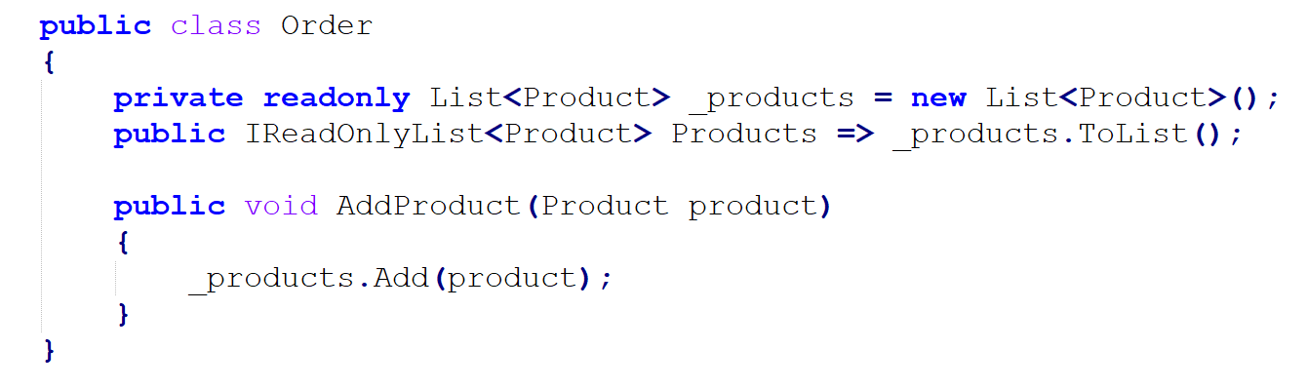
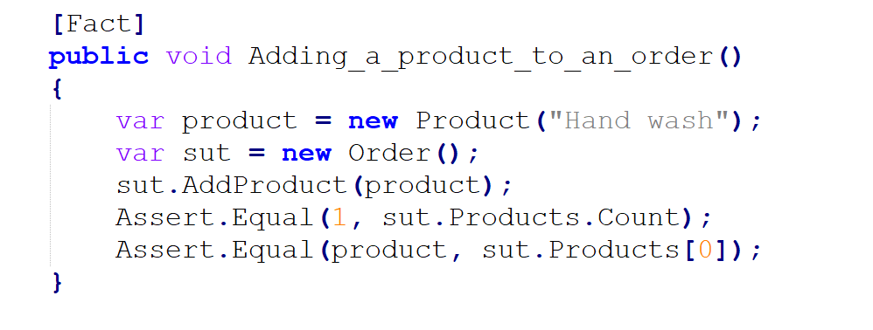
State-based testing
Verifying the state of the system after an operation is completed.
Notes:
The test verifies the Products collection after the addition is completed. Unlike the example of output-based testing in listing 6.1, the outcome of AddProduct() is the change made to the order’s state. The term state in this style of testing can refer to the state of the SUT itself, of one of its collaborators, or of an out-of-process dependency, such as the database or the filesystem.

Slide 7
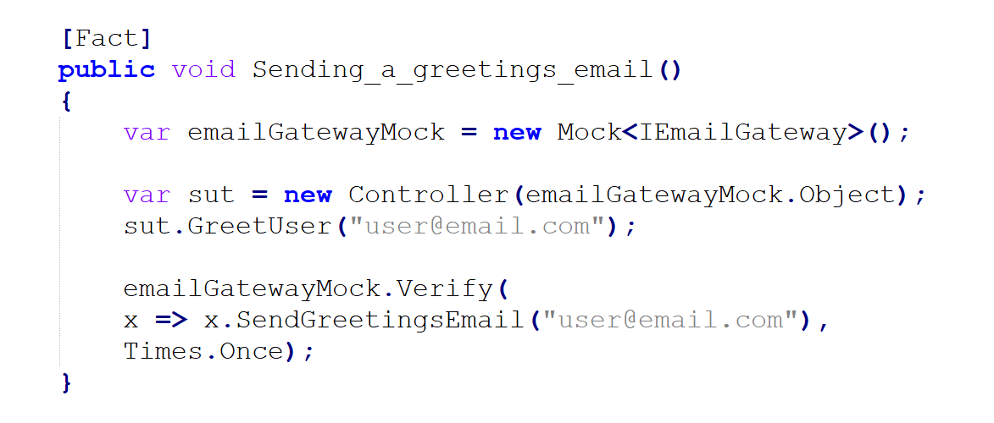
Communication-based style
Uses mocks to verify communications between the system under test and its collaborators
Notes:
This style uses mocks to verify communications between the system under test and its collaborators

Slide 8
Comparing the three styles of unit testing

Slide 9
Three metrics of a good unit test
Protection against regressions and feedback speed
Resistance to refactoring
Maintainability
Notes:
In short you make a one Arrange for all your unit test

Slide 10
Protection against regressions and feedback speed
Doesn’t depend on a particular style of testing
Three characteristics of this metric are:
The amount of code that is executed during the test
The complexity of that code
Its domain significance
Notes:
Generally, you can write a test that exercises as much or as little code as you like; no particular style provides a benefit in this area. The same is true for the code’s complexity and domain significance Communication-based testing can be slightly worse because mocks tend to introduce additional latency at runtime. But the difference is negligible, unless you have tens of thousands of such tests

Slide 11
Resistance to refactoring
Measure of how many false positives (false alarms) tests generate during refactoring.
Output-based:
Best protection against false positives because
State-based:
Prone to false positives
Communication-based:
Most vulnerable to false alarms
Notes:
Output-based: the resulting tests couple only to the method under test.
The only exception is the communication-based style: overusing it can result in shallow tests that verify only a thin slice of code and mock out everything else. Such shallowness is not a definitive feature of communication based testing, though, but rather is an extreme case of abusing this technique.
Communication-based testing can be slightly worse because mocks tend to introduce additional latency at runtime.

Slide 12
Maintainability
highly correlated with the styles of unit testing;
Output-based:
Tests are almost always short and concise and thus are easier to maintain.
Communication-based:
Worse than output-based and state-based tests on the maintainability metric. .
Notes:
but, unlike with resistance to refactoring, there’s not much you can do to mitigate that..
State Based - This Is sbecause state verification often takes up more space than output verification.
Communication-based testing: - requires setting up test doubles and interaction assertions, and that takes up a lot of space.
Tests become even larger and less maintainable when you have mock chains (mocks or stubs returning other mocks, which also return mocks, and so on, several layers deep).

Slide 13
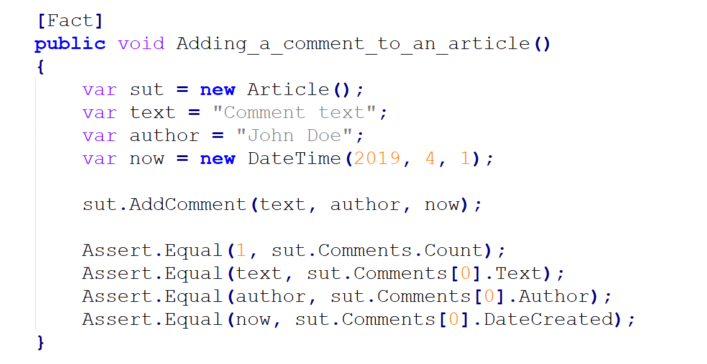
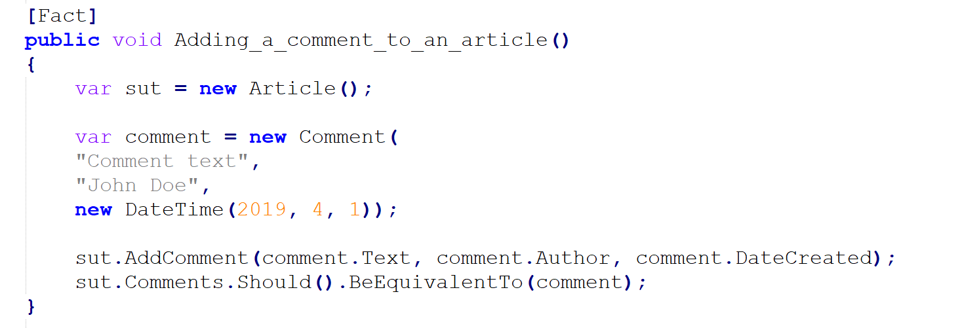
Maintainability
State-based:
Tests are normally less maintainable than output-based ones.
Notes:
but, unlike with resistance to refactoring, there’s not much you can do to mitigate that..
State Based is less maintanable - This Is because state verification often takes up more space than output verification.
This test uses the fact that comments can be compared as whole values, without the need to assert individual properties in them. It also uses the BeEquivalentTo method from Fluent Assertions, which can compare entire collections, thereby removing the need to check the collection size.

Slide 14
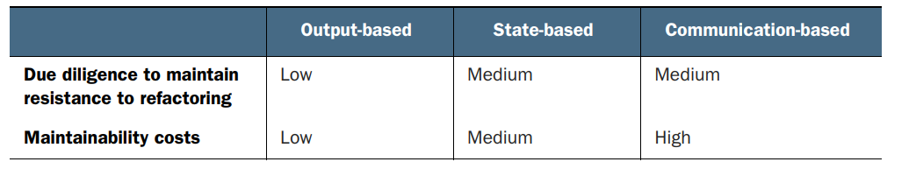
Comparison
Notes:
State-based and communication-based tests are worse on both metrics. These are more likely to couple to a leaking implementation detail, and they also incur higher maintenance costs due to being larger in size
Always prefer output-based testing over everything else. Unfortunately, it’s easier said than done. This style of unit testing is only applicable to code that is written in a functional way, which is rarely the cause for most object-oriented programming languages. Still, there are techniques you can use to transition more of your tests toward the output-based style.
The rest of this chapter shows how to transition from state-based and collaboration based testing to output-based testing. The transition requires you to make your code more purely functional, which, in turn, enables the use of output-based tests instead of state- or communication-based ones.

Slide 15
Understanding functional architecture

Slide 16
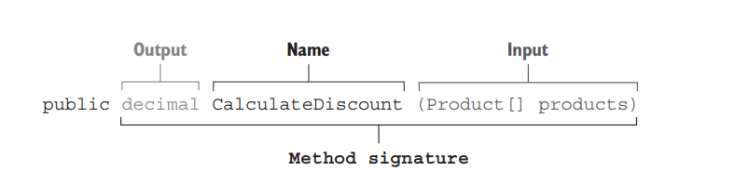
What is functional programming?
Functional programming is programming with mathematical functions. A mathematical function (also known as pure function) is a function (or method) that doesn’t have any hidden inputs or outputs.
All inputs and outputs of a mathematical function must be explicitly expressed in its method signature, which consists of the method’s name, arguments, and return type.
Notes:
the output-based unit testing style is also known as functional. That’s because it requires the underlying production code to be written in a purely functional way, using functional programming. So, what is functional programming? All inputs and outputs of a mathematical function must be explicitly expressed in its method signature, which consists of the method’s name, arguments, and return type. A mathematical function produces the same output for a given input regardless of how many times it is called. Methods with no hidden inputs and outputs are called mathematical functions because such methods adhere to the definition of a function in mathematics.

Slide 17
Types of hidden inputs and outputs
Side effect
Exceptions
Reference to an internal or external state

Slide 18
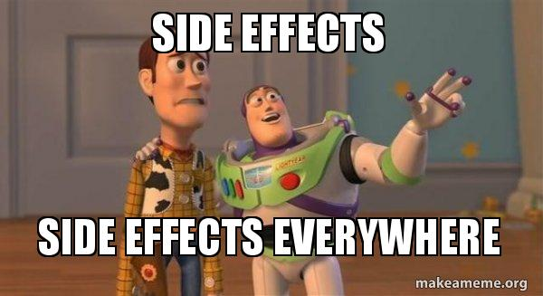
Side effects
An output that isn’t expressed in the method signature and, therefore, is hidden
An operation creates a side effect when it mutates the state of a class instance, updates a file on the disk, and so on.
Notes:
Side effects—A side effect is an output that isn’t expressed in the method signature and, therefore, is hidden. An operation creates a side effect when it mutates the state of a class instance, updates a file on the disk, and so on.

Slide 19
Exceptions
When a method throws an exception
introducing an additional output that the method signature doesn’t convey
Notes:
○ Exceptions—When a method throws an exception, it creates a path in the program flow that bypasses the contract established by the method’s signature. The thrown exception can be caught anywhere in the call stack, thus introducing an additional output that the method signature doesn’t convey.

Slide 20
Reference to an internal or external state
It can query data from the database, or it can refer to a private mutable field
Ex:
time using a static property such as DateTime.Now
Notes:
These are all inputs to the execution flow that aren’t present in the method signature and, therefore, are hidden. A reference to an internal or external state—For example, a method can get the current date and time using a static property such as DateTime.Now. It can query data from the database, or it can refer to a private mutable field. These are all inputs to the execution flow that aren’t present in the method signature and, therefore, are hidden.

Slide 21
5 MINS BREAK

Slide 22
Which one is the Mathematical Function?
Mathematical function
not a mathematical function
public int Increment(int x) { return x + 1; }
int x = 0; public int Increment() { x++; return x; }
Notes:
On the other hand, the following method is not a mathematical function. You can’t replace it with the return value because that return value doesn’t represent all of the method’s outputs. In this example, the hidden output is the change to field x (a side effect):

Slide 23
What is functional architecture?
Separation between code that handles business logic and code that incurs side effects.
Notes:
The goal of functional programming is not to eliminate side effects altogether but rather to introduce a separation between code that handles business logic and code that incurs side effects.
Pag meron ka business logic bilang oop wag reference …. Gawin mo functional…
Return mile

Slide 24
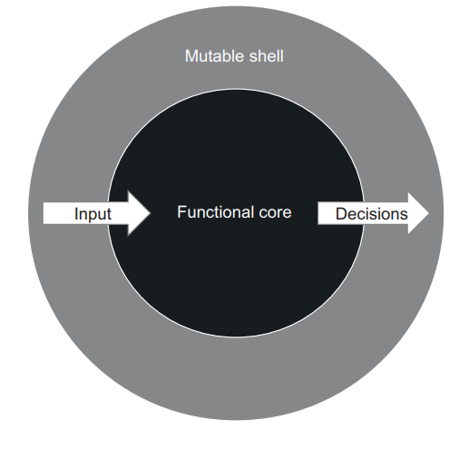
Functional architecture divides all code into two categories
Functional core
Makes decision or Generate decision
Mutable shell
Supplies input data to the functional core and converts decisions the core makes into side effects
Notes:
The separation between business logic and side effects is done by segregating two types of code: ○ Code that makes a decision—This code doesn’t require side effects and thus can be written using mathematical functions. ○ Code that acts upon that decision—This code converts all the decisions made by the mathematical functions into visible bits, such as changes in the database or messages sent to a bus.

Slide 25
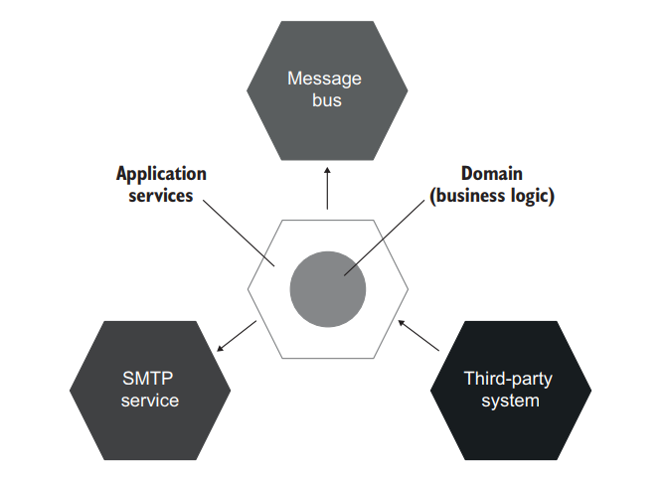
Comparing functional and hexagonal architectures
Hexagon Archi.
Notes:
Functional architecture pushes all side effects out of the immutable core to the edges of a business operation. These edges are handled by the mutable shell. On the other hand, the hexagonal architecture is fine with side effects made by the domain layer, as long as they are limited to that domain layer only. the hexagonal architecture differentiates the domain layer and the application services layer (figure 6.10). The domain layer is accountable for business logic while the application services layer, for communication with external applications such as a database or an SMTP service. Key world – Functional ache is self-sufficient – independent

Slide 26
Transitioning to functional architecture and output-based testing
Moving from using an out-of-process dependency to using mocks
Moving from using mocks to using functional architecture
Notes:
we’ll take a sample application and refactor it toward functional architecture.
We’ll refactor state-based and communication based tests to the output-based style of unit testing

Slide 27
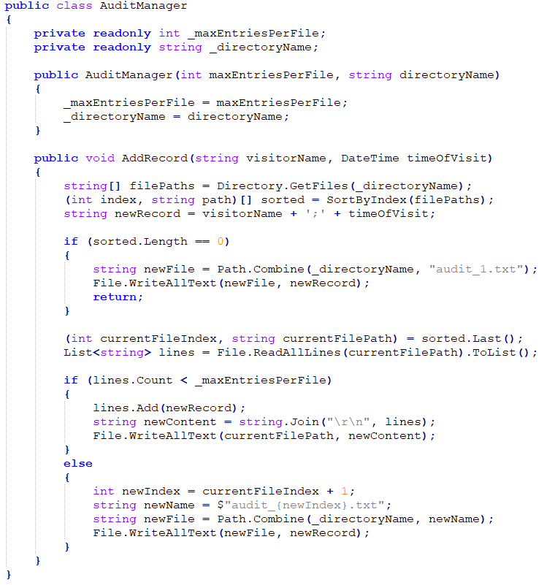
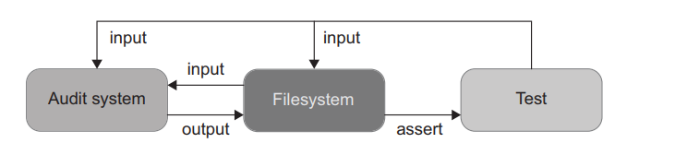
Example:
AuditManager is the main class
Constructor accepts the maximum number of entries per file and the working directory as configuration parameters.
The only public method in the class is AddRecord.
Notes:
The audit system stores information about visitors in text files with a specific format. When the maximum number of entries per file is reached, the system creates a new file
Simple lang to code:
Retrieves a full list of files from the working directory
Sorts them by index (all filenames follow the same pattern: audit_{index}.txt [for example, audit_1.txt])
If there are no audit files yet, creates a first one with a single record
If there are audit files, gets the most recent one and either appends the new record to it or creates a new file, depending on whether the number of entries in that file has reached the limit

Slide 28
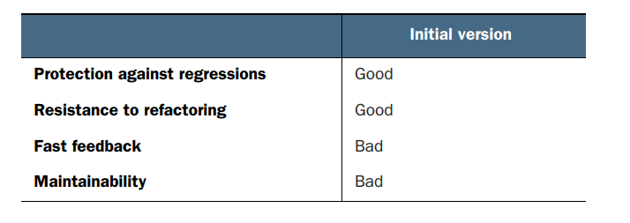
Notes:
The AuditManager class is hard to test as-is, because it’s tightly coupled to the filesystem. Before the test, you’d need to put files in the right place, and after the test finishes, you’d read those files, check their contents, and clear them out
They don’t comply with the second and the third attributes of a unit test, thereby falling into the category of integration tests
A unit test verifies a single unit of behavior, ○ Does it quickly, ○ And does it in isolation from other tests.

Slide 29
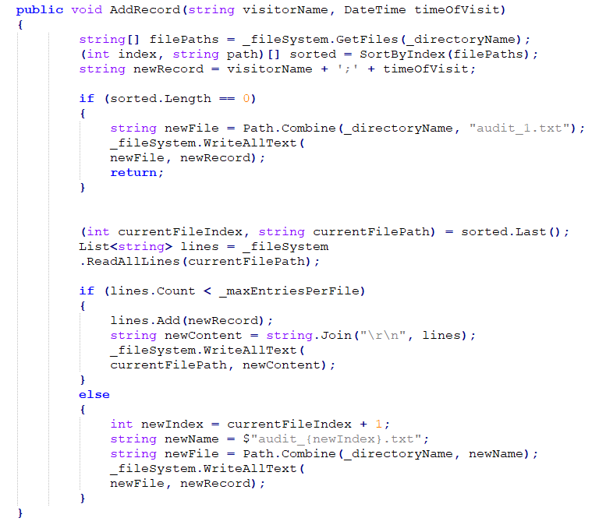
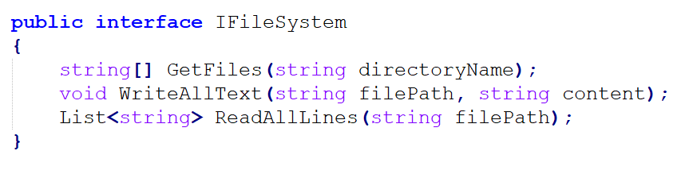
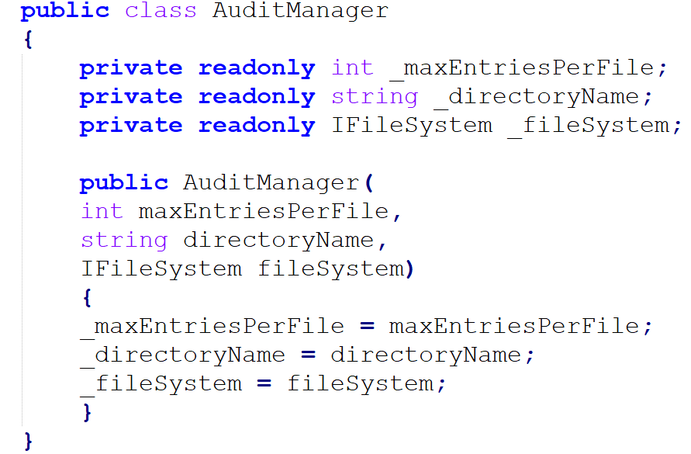
Example Code
Audit Manager
Notes:
Let create Interface para ma mock natin yung fileSystem or pag create or update ng file

Slide 30
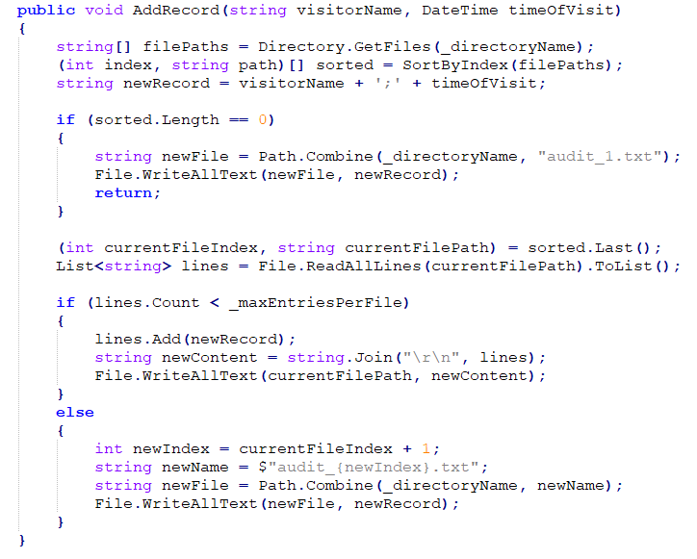
Initial Version
Interface Version

Slide 31
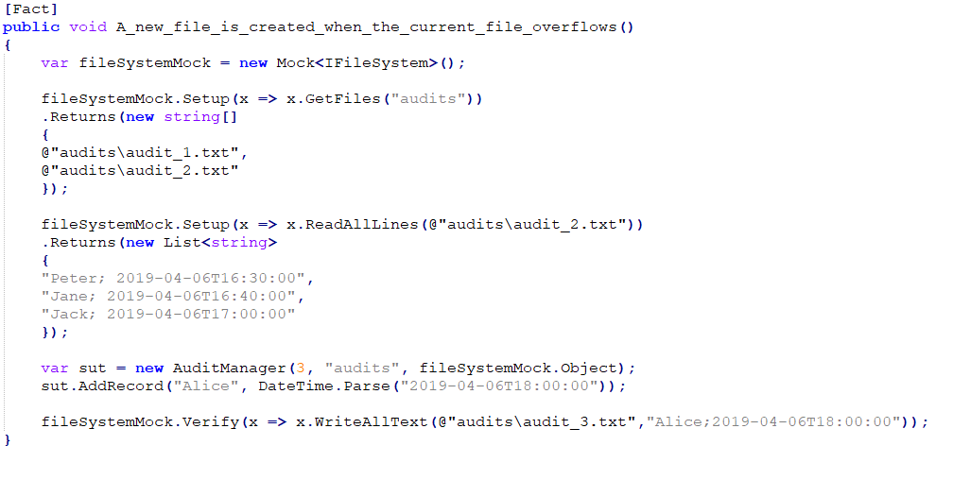
Example Code
Audit Manager

Slide 32
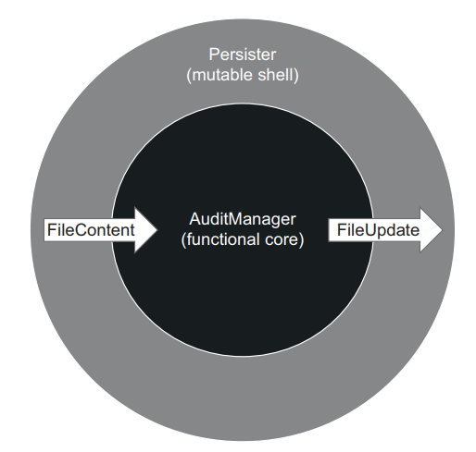
Refactoring toward functional architecture
Instead of hiding side effects behind an interface and injecting that interface into AuditManager, you can move those side effects out of the class entirely. AuditManager is then only responsible for making a decision about what to do with the files.
Add new class, Persister, acts on that decision and applies updates to the filesystem
Notes:
Instead of hiding side effects behind an interface and injecting that interface into AuditManager, you can move those side effects out of the class entirely. AuditManager is then only responsible for making a decision about what to do with the files. A new class, Persister, acts on that decision and applies updates to the filesystem (figure

Slide 33
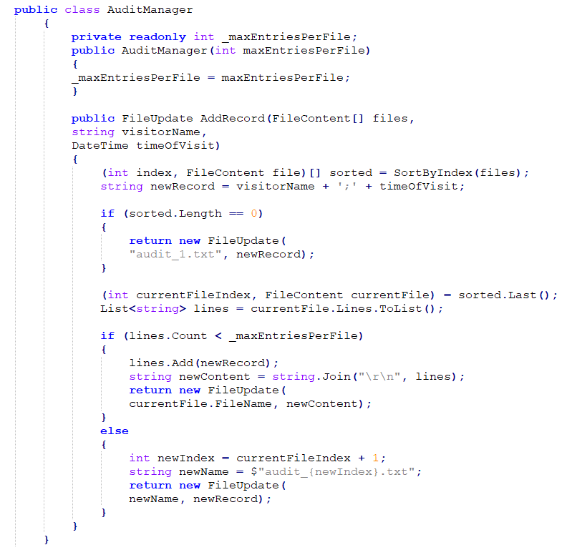
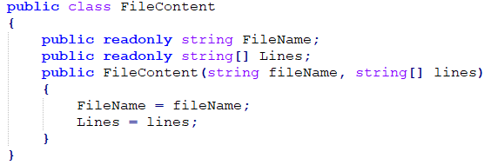
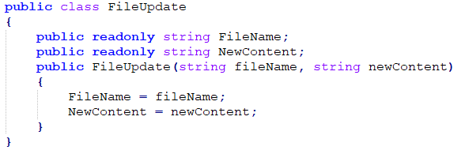

Slide 34
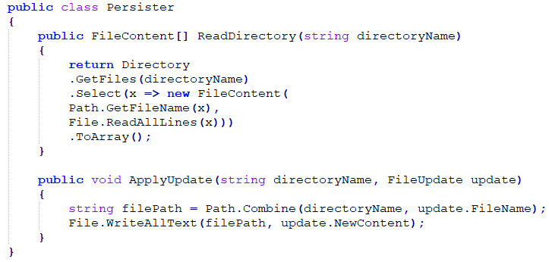
Notes:
All it does is read content from the working directory and apply updates it receives from AuditManager back to that working directory.

Slide 35
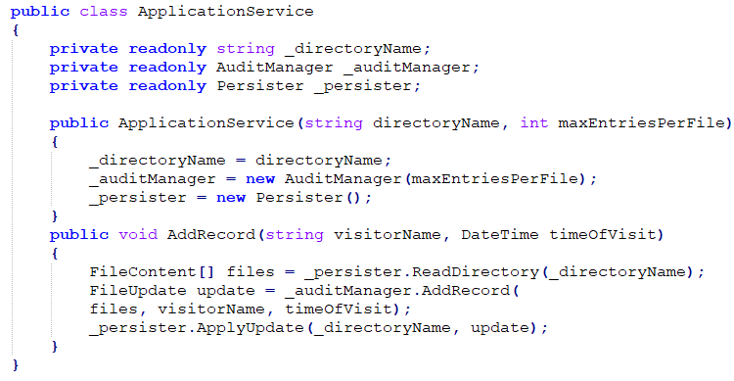
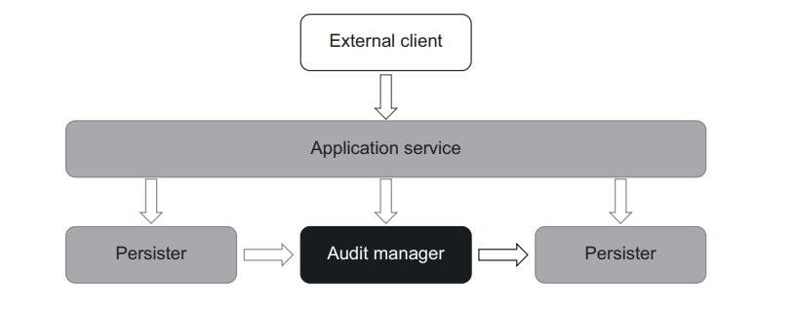

Slide 36
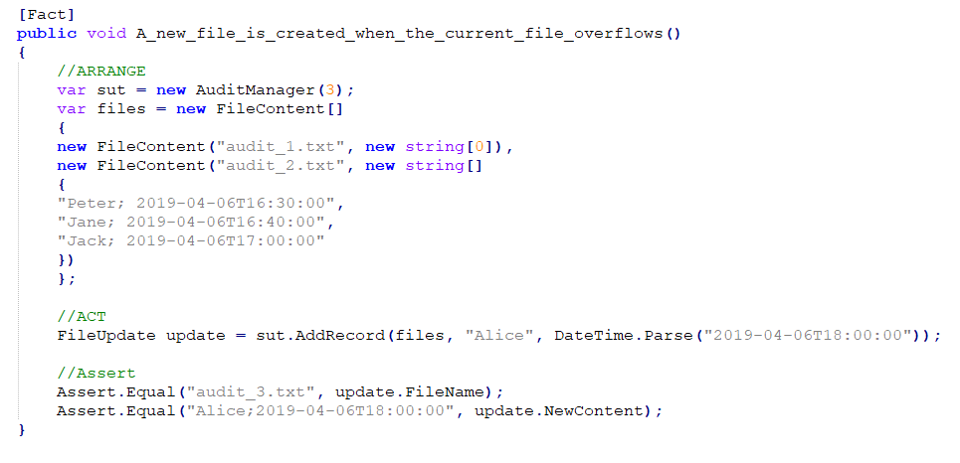

Slide 37
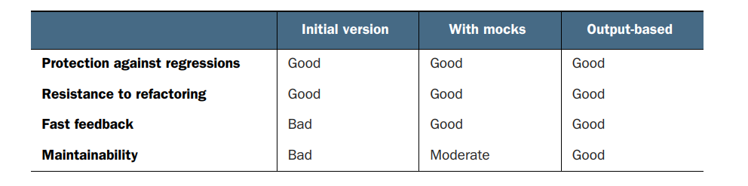

Slide 38
Drawbacks of functional architecture

Slide 39
Understanding the drawbacks of functional architecture
Unfortunately, functional architecture isn’t always attainable.
Maintainability benefits are often offset by a performance impact and increase in the size of the code base

Slide 40
Applicability of functional architecture and summary
Functional architecture worked for our audit system because this system could gather all the inputs up front, before making a decision.
The choice between a functional architecture and a more traditional one is a trade-off between performance and code maintainability.
Not all code bases are worth converting into functional architecture. Apply functional architecture strategically. Take into account the complexity and the importance of your system.
Notes:
Functional architecture concedes performance for maintainability gains.
In code bases that are simple or not that important, the initial investment required for functional architecture won’t pay off.

Slide 41
Summary
Output-based testing is a style of testing where you feed an input to the SUT and check the output it produces.
State-based testing verifies the state of the system after an operation is completed.
Communication-based testing, you use mocks to verify communications between the system under test and its collaborator
Functional programming is programming with mathematical functions.
The goal of functional programming is to introduce a separation between business logic and side effects.
The difference between functional and hexagonal architectures is in their treatment of side effects. Functional architecture pushes all side effects out of the domain layer. Conversely, hexagonal architecture is fine with side effects made by the domain layer, as long as they are limited to that domain layer only.

Slide 42
Thank you! Question?

